Slide 1
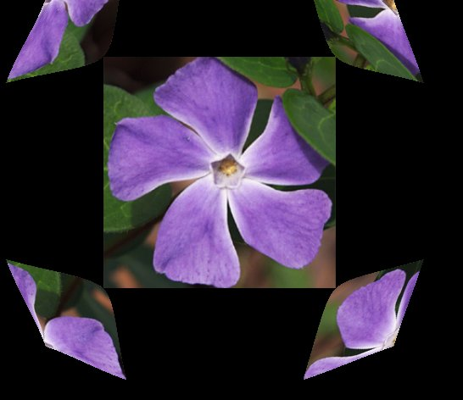
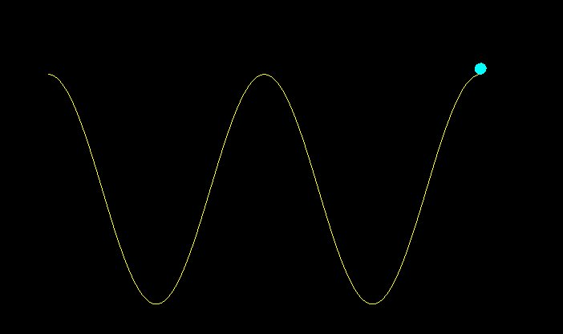
Computer Animation
[Demo]

Slide 2
Computer Animation
Frame-to-Frame animation:
Key frame -- the specified and detailed object drawing at a time instance in the animation sequence
Interpolation – generate object drawing of the frames in-between a pair of key frames based on the specified key frames

Slide 3
Computer Animation
Frame-to-Frame animation (cont’d):
Parameterized animation system: -- the object-motion characteristics are specified, the parameters are adjustable for controlling the object change (such as the motion, the shape, the illumination, textures, etc).

Slide 4
Key Frame Techniques
Morphing and Warping
-- transform the graphical objects from one to another
-- The change includes shape, attributes (e.g., intensity, color, etc.)
Motion path determination
Motion speed control

Slide 5
Motion Path
Motion path determination:
Direct specification of the motion parameters (e.g., rotation, translation vectors, explicit math representation of the motion curve)
-- e.g., circle; damped sine curve
Kinematics and Dynamics
-- specify the position, velocity and acceleration of the motions
-- no forces to be considered
Physically based method
-- Specify the forces that produce the velocities and accelerations
-- e.g., F = ma (Newton’s second law for a particle of mass m)
Key frame interpolation
-- curve-fitting techniques
-- e.g., spline interpolation based on the key control points

Slide 6
Animation Speed
Animation speed control:
Constant speed
-- equal interval time spacing (dT)
-- dT = (T2-T1)/(n+1)
Key frames at T1 and T2
There are n frames to be interpolated in-between T1 and T2
-- The time for intermediate frame j
t(j) = T1 + j dT (j = 1, 2, …, n)

Slide 7
Animation Speed
Animation speed control:
Increasing speed
t(j) = T1 + (T2-T1) [1 – cos(j π /(2(n+1))]
(j=1, 2, .., n)
Note: 1 –cos(θ) (0< θ < π/2) can model the increasing speed
(positive acceleration)

Slide 8
Animation Speed
Animation speed control:
Decreasing speed
t(j) = T1 + (T2-T1) [sin(j π /(2(n+1))]
(j=1, 2, .., n)
Note: sin(θ) (0< θ < π/2) can model the decreasing speed
(deceleration)

Slide 9
Animation Speed
Animation speed control:
Slow-in-Slow-out
t(j) = T1 + (T2-T1) [1 - cos(j π /(n+1)]/2
(j=1, 2, .., n)
Note: [1- cos(θ)]/2 (0< θ < π/2) can model the acceleration- deceleration function

Slide 10
Animation Programming
Animation = Redraw + Double-Buffer Swap
glutSwapBuffer(void) (OpenGL GLUT)
SwapBuffers(HDC) (MSWindow API)

